Slide 1
CIS 700-004: Lecture 7M
Autoencoders
02/25/19
Notes:
Done

Slide 2
Low-dimensional representations
Notes:
Done

Slide 3
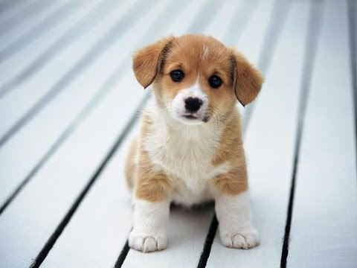
Notes:
Done

Slide 4
Representations
What are the important aspects of data
e.g. dog, young, cute, brown
Representation space for numbers is logarithmic across cultures.
Representation space for colors differs across cultures.
Notes:
Done

Slide 5
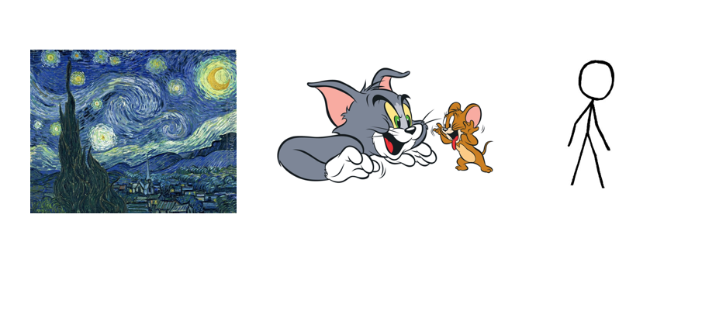
Artificial vs. biological representations
Notes:
Done

Slide 6
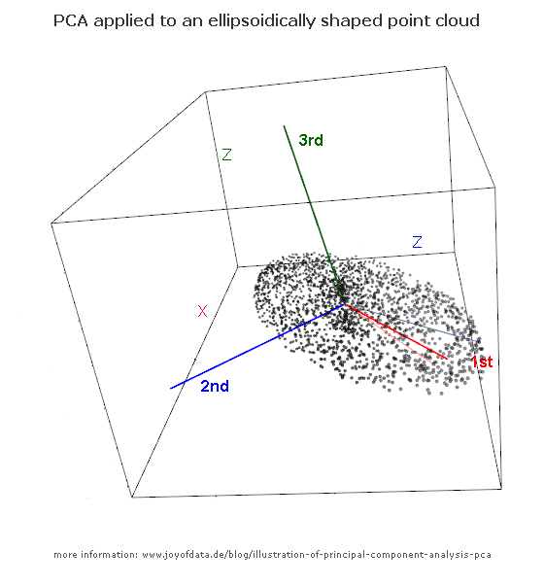
PCA
Notes:
Done

Slide 7
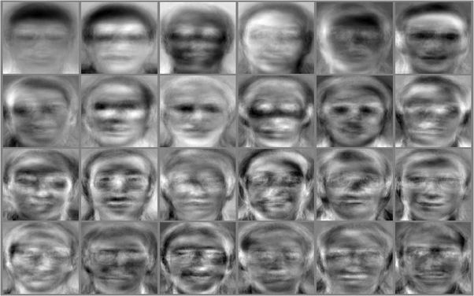
PCA
Notes:
Done

Slide 8

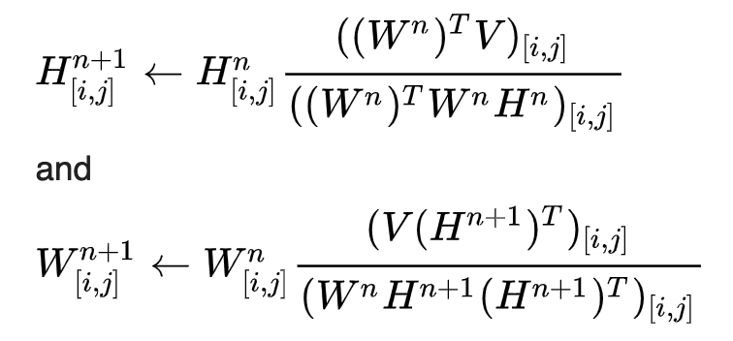
Non-negative matrix factorization (NMF)
All matrices non-negative
Features easier to interpret
Often negative weights would be weird
Popular algorithm (Lee & Seung):
Notes:
Done

Slide 9
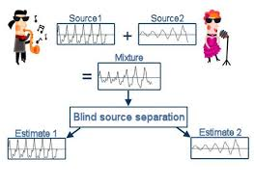
Independent component analysis (ICA)
Used to separate mixture of signals.
“Blind source separation”
Uses assumption that each signal is “far from random”
Sums of signals become more Gaussian
Optimize for non-Gaussian signals
Notes:
Done

Slide 10
Autoencoders
Notes:
Done

Slide 11
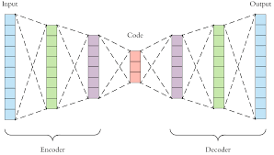
Basic architecture
Notes:
Done

Slide 12
Training
“Self-supervised” training: desired output Y is just input X
e.g. MSE loss
Small bottleneck layer impedes training
Notes:
Done

Slide 13
What is a linear autoencoder?
What happens if no nonlinearity?
Linear encoder and decoder
Almost exactly PCA, but no order on principal components
If L2 on encoder and decoder, exactly PCA (Kunin et al. 2019)
Notes:
Done

Slide 14
Convolutional autoencoders
Decoder has to “undo” the convolution / pooling
Generally involves upsampling
Also conv layers reducing # of features
Notes:
Done

Slide 15
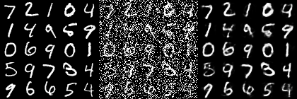
Denoising autoencoders
Noise deliberately added to make representation better
Bonus: unsupervised denoising algorithm
Notes:
Done

Slide 16
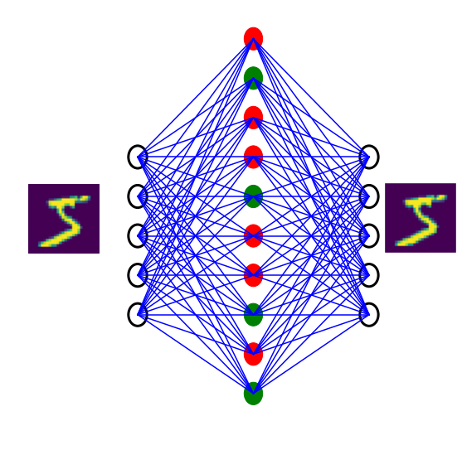
Sparse autoencoders
Wide instead of narrow bottleneck
Sparse activation in the “bottleneck”
Penalty in loss if too many are nonzero
Notes:
Done

Slide 17
Variational autoencoders (VAEs) - motivation
Want the low-dim representation z to have independent components
Each component should contribute a similar amount
z according to unit Gaussian
Example:
Low-dim representation of faces - eye color, hair length, etc.
Each feature should be independent
Scale so each feature has same variance
Notes:
Done

Slide 18

VAEs - objective
Ingredients:
Encoder q (trained network)
Decoder r (trained network)
Prior p on z (fixed)
Regularization
Reconstruction loss
Notes:
Done

Slide 19
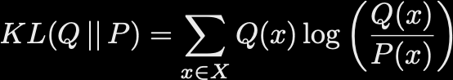
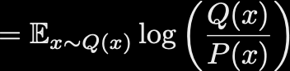
What is the KL divergence?
Measure of difference between prob distributions
Notes:
Done

Slide 20
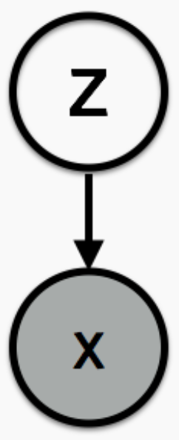

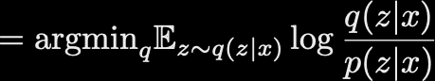

VAEs - mathematical motivation
Graphical model: latent features z generate data x
Want to compute p(z | x), but hard so approximate q(z | x)
Notes:
Done

Slide 21

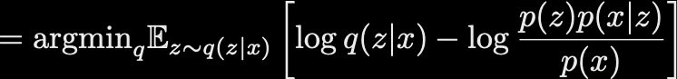


VAEs - mathematical motivation
Notes:
Done

Slide 22

VAEs - mathematical motivation
Regularization
Negative log likelihood
Compare to the original VAE definition:
The reconstruction loss is exactly the negative log likelihood for Gaussian distributions.
Regularization
Reconstruction loss
Notes:
Done

Slide 23
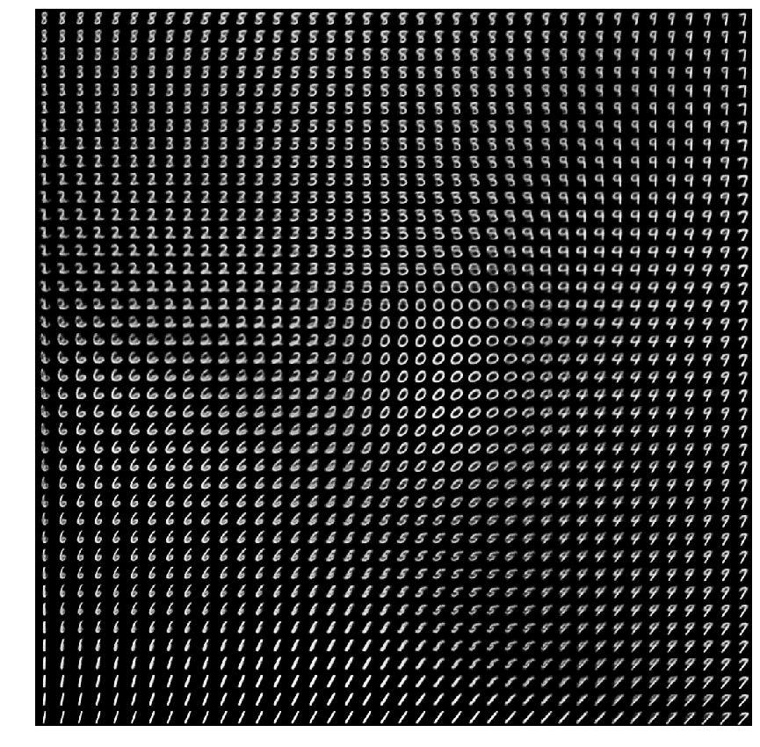
Notes:
Done

Slide 24
Autoencoders in PyTorch

Slide 25
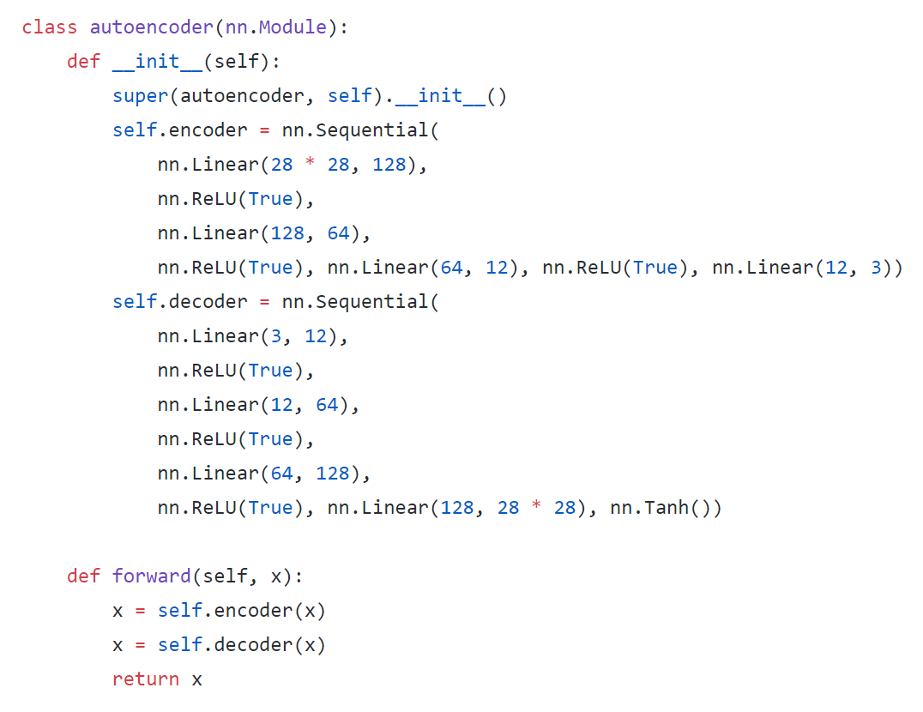
Simple autoencoders
Notes:
https://github.com/L1aoXingyu/pytorch-beginner/tree/master/08-AutoEncoder

Slide 26
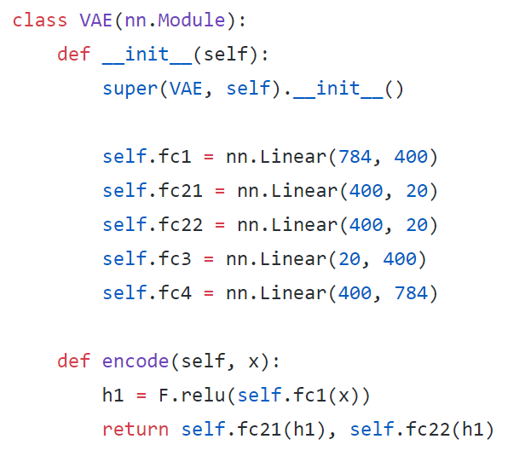
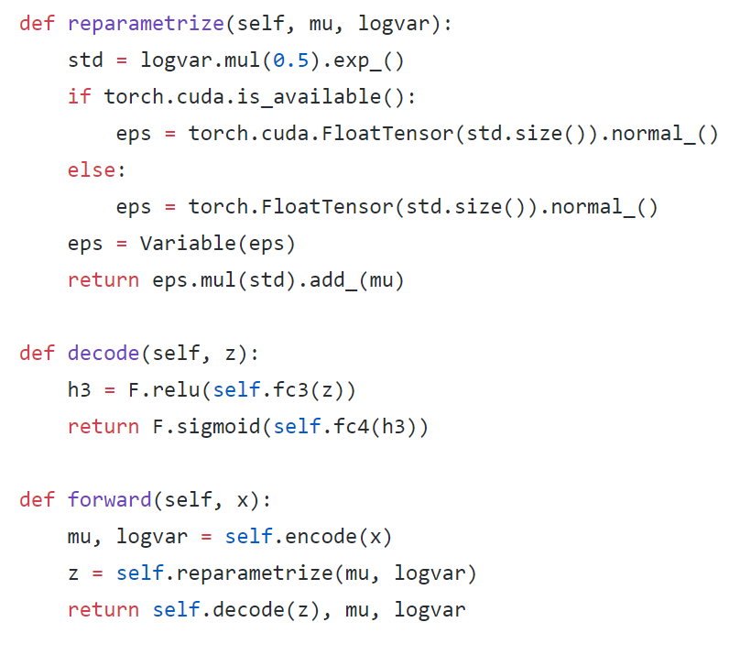
Variational autoencoders

Slide 27
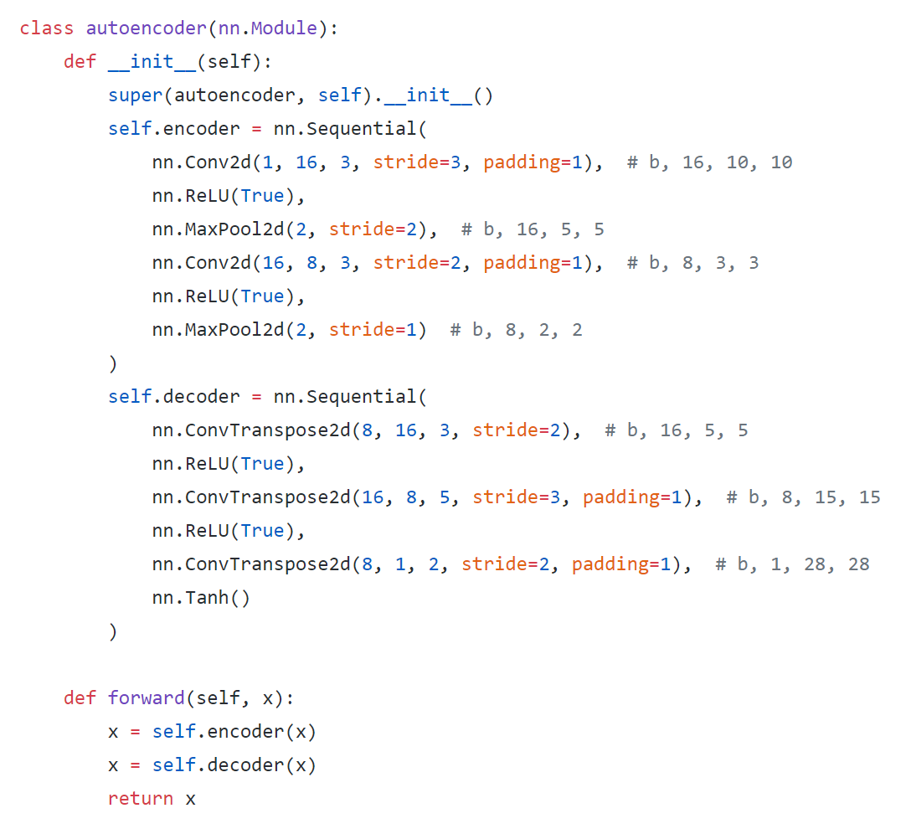
Convolutional autoencoders
Notes:
https://github.com/L1aoXingyu/pytorch-beginner/tree/master/08-AutoEncoder

Slide 28
Adversarial examples
Notes:
Done

Slide 29
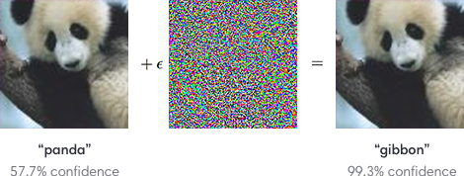
What is an adversarial example?
Notes:
Done

Slide 30
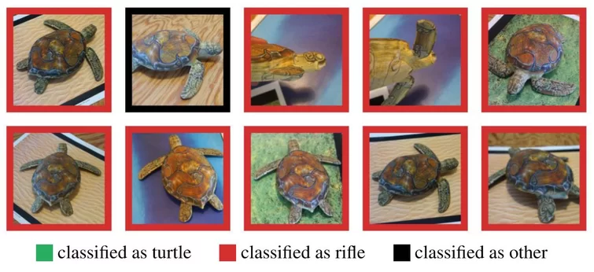
What is an adversarial example?
Notes:
Done

Slide 31
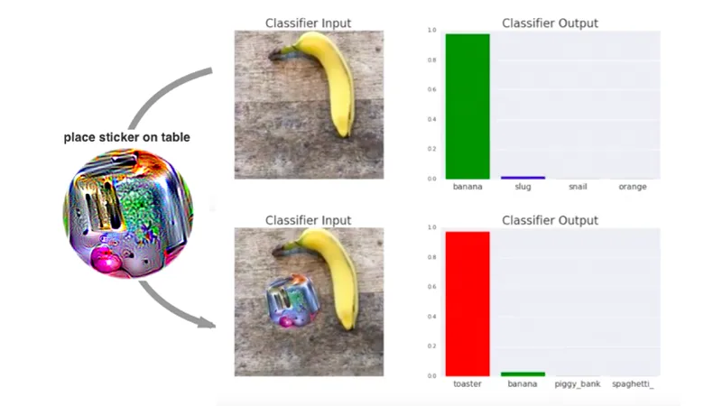
What is an adversarial example?
Notes:
Done

Slide 32
Basic method = Fast Gradient Sign (FGS)
Fixed network weights
Gradient descent on the image
Optimize for changing the predicted label
Change pixel by epsilon times sign of gradient
Lots of dimensions - often close to a decision boundary
Small changes to many pixels add up
Notes:
Done

Slide 33
Information bottleneck
Notes:
Done

Slide 34
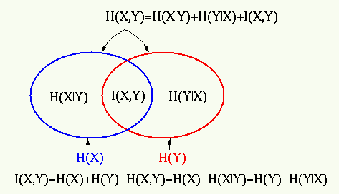
Mutual information I(X, Y)
How much info shared between X and Y.
Notes:
Done

Slide 35

The basic idea
For input X, desired output Y, the intermediate representation T should:
maximize mutual information about Y (fitting)
minimize mutual information about X (compression)
Notes:
Done

Slide 36
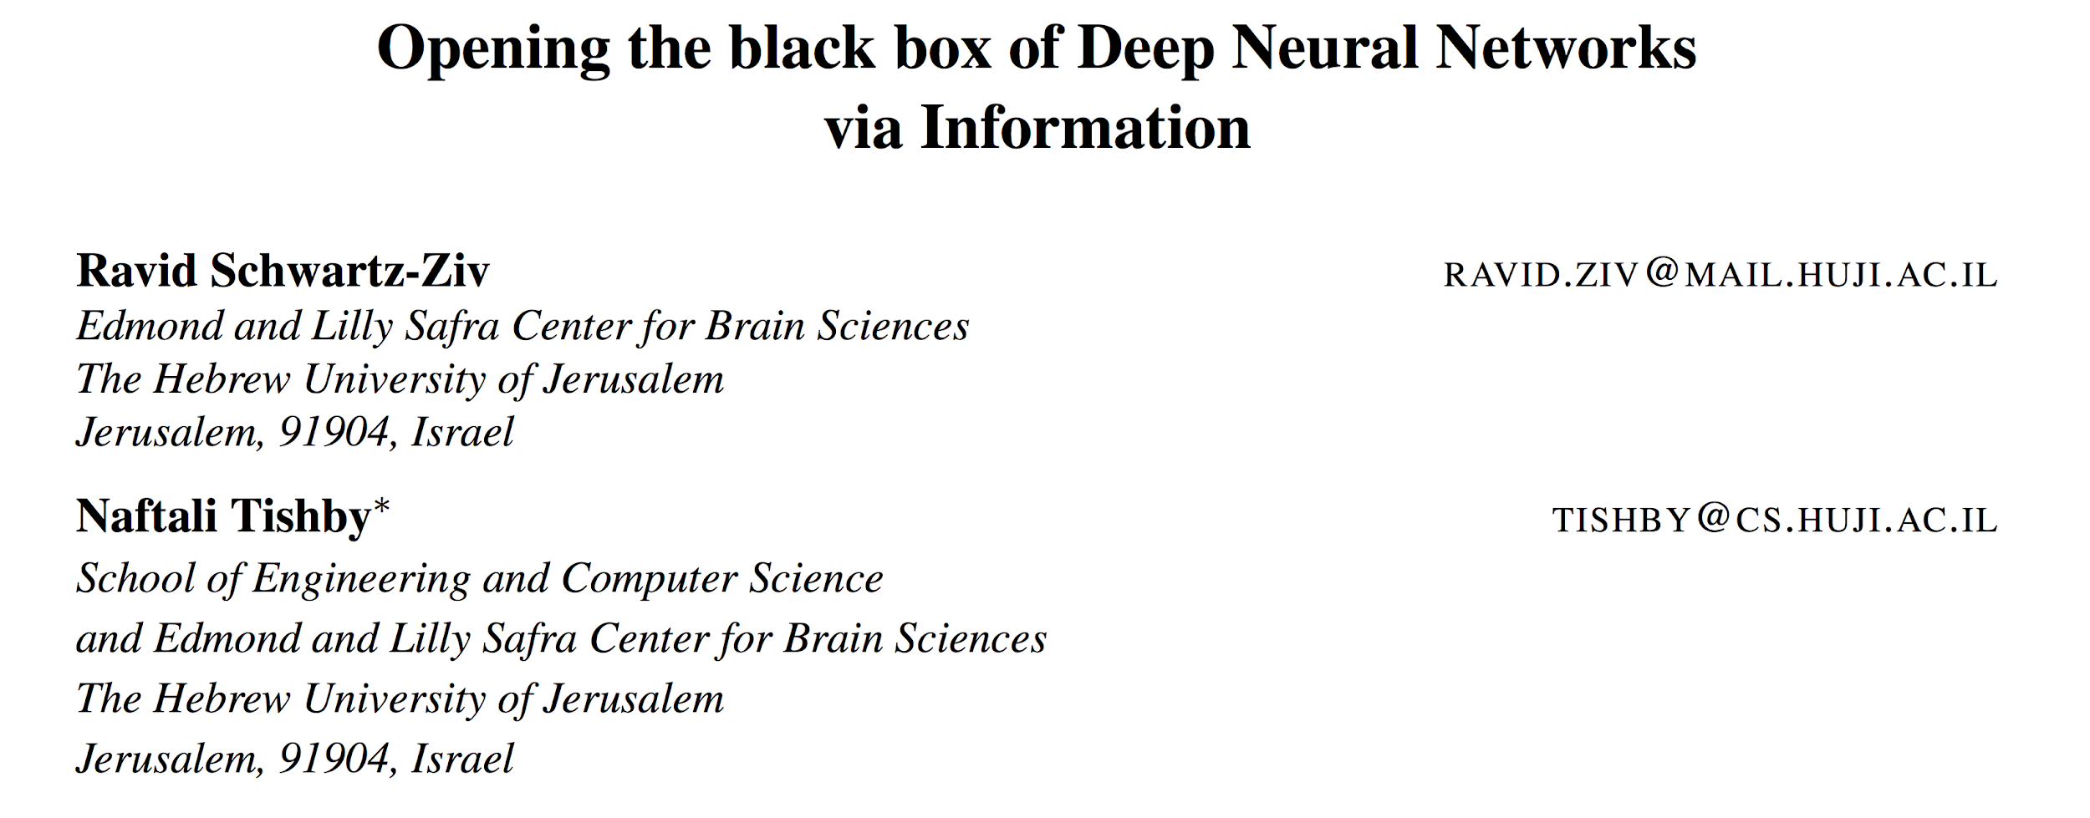
A controversial paper
Notes:
Done

Slide 37
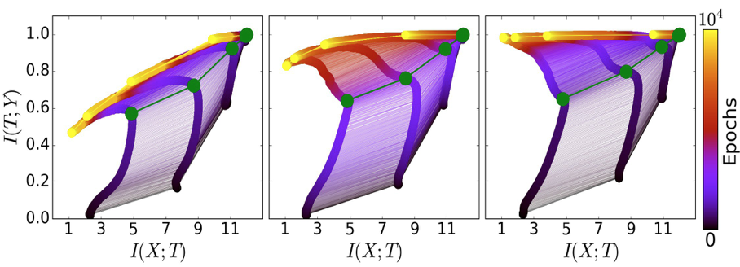
Neural nets naturally achieve information bottleneck?
“Fitting” phase: I(T; Y) goes up
“Compression” phase: I(X; T) goes down
Claim that for less training data, compression lowers I(T; Y)
5% training data
45% training data
85% training data
Notes:
Done

Slide 38
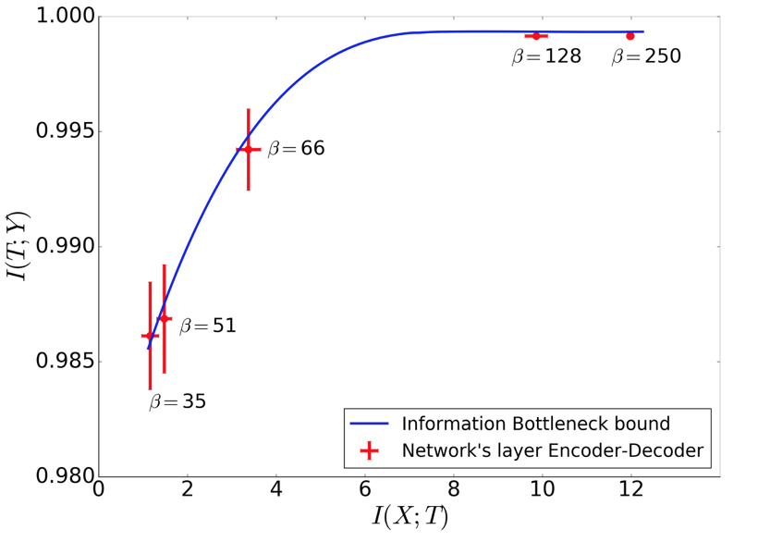
The paper claims...
On a toy task, different layers optimize for different beta.
Notes:
Done

Slide 39
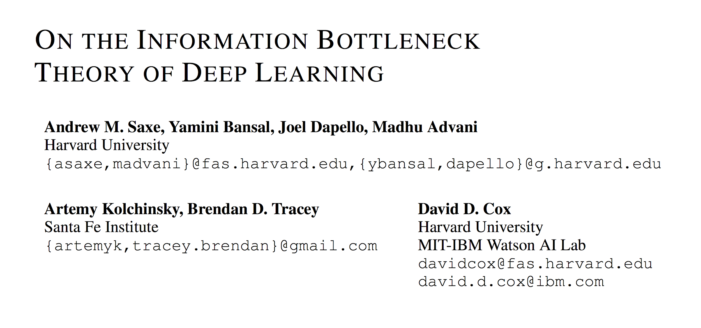
Probably not
Notes:
Done

Slide 40

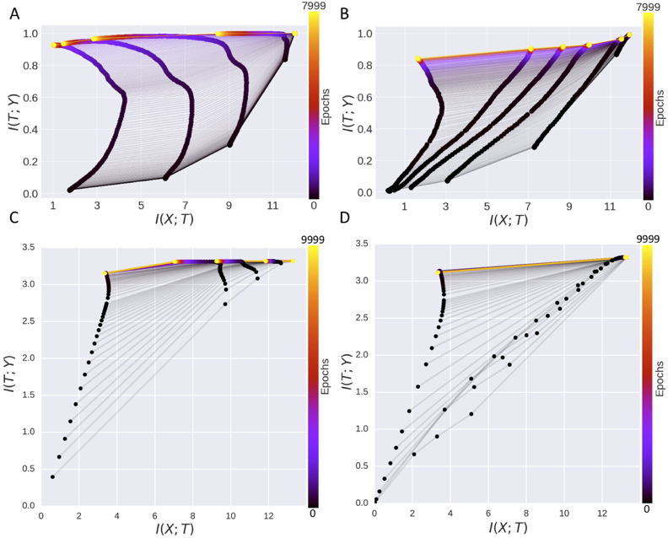
Probably not
tanh
ReLU (+ softmax)
Approx of mutual information uses bins.
When tanh saturated (at 1 or -1), outputs concentrated in two bins.
Thus, estimate of I(X; T) goes down.
Not for ReLU - or if use a more accurate approx for tanh.
Notes:
Done

Slide 41

Variational information bottleneck (VIB)
Explicitly optimize:
Hard to compute, so use variational approximation
Details similar to VAE
Essentially identical objective - “encoder” q and “decoder” r:
Notes:
Done

Slide 42
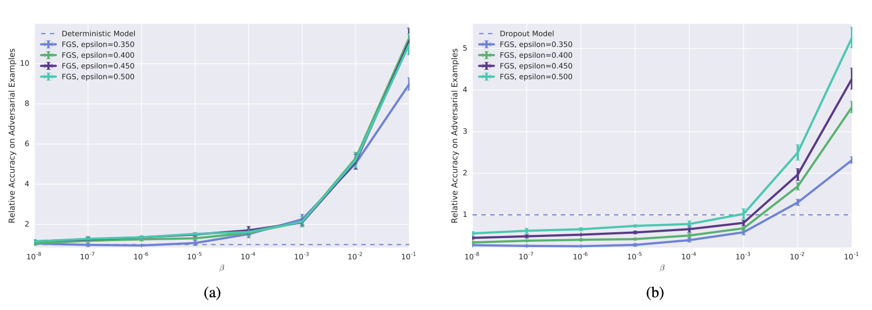
VIB => robustness to adversary
Notes:
Done

